Slide 1
Relational Frame Theory and the Symbolic Inheritance Stream:
In Search of a Useful and Evolutionarily Plausible
Account of Human Language

Slide 2
Orientation to the Panel

Slide 3
RFT and EvoS: Why Care?
1. Evolution science needs the behavioral tradition whether they know it or not, ironically for some of the very reasons that led to a split between them
Notes:
There was no “black box” and no “tabula rasa”
The analysis of biological systems based on variation and selective retention.
My biases are more (b)VSR than BVSR (and the symbolic stream is a good reason why).

Slide 4
RFT and EvoS: Why Care?
2. The “depth” that CBS seeks requires integration with biology and a EvoS contains a wing of functional contextual biology,
3. Evolution science has a proven ability to integrate disparate fields
Notes:
There was no “black box” and no “tabula rasa”
The analysis of biological systems based on variation and selective retention.
My biases are more (b)VSR than BVSR (and the symbolic stream is a good reason why).

Slide 5
RFT and EvoS: Why Care?
4. Multi-dimensional and multi-level evolutionary processes specify the history and context of action in an elaborated way may allow us better to measure and manipulate key functional processes now
The ultimate point is creating a more useful account
Notes:
There was no “black box” and no “tabula rasa”
The analysis of biological systems based on variation and selective retention.
My biases are more (b)VSR than BVSR (and the symbolic stream is a good reason why).

Slide 6
In the 1970s Behavioral Psychology and EvoS Had a Falling Out But Understanding Why Helps See What CBS Brings to the Table
Examples critics cite
  Taste Aversion
  Imprinting
  “That all events are equally associable and obey common laws is a central assumption of general process learning theory” Seligman, 1972 (so-called “blank slate”)
Notes:
There was no “black box” and no “tabula rasa”
The analysis of biological systems based on variation and selective retention.
My biases are more (b)VSR than BVSR (and the symbolic stream is a good reason why).

Slide 7
Blank Slates Are Not the Issue. Rather,
General Processes Are Plausible and Important and Stick to Acts in Context
“The behavior of organisms is a single field in which both phylogeny and ontogeny must be taken into account” (Skinner, 1977)
“Operant condition [is] itself an evolved feature of an organism” (Skinner, 1975)
[There is] “a continuous shaping process, in both ongenic and phylogenic behavior” (Skinner, 1975)
Notes:
There was no “black box” and no “tabula rasa”
The analysis of biological systems based on variation and selective retention.
My biases are more (b)VSR than BVSR (and the symbolic stream is a good reason why).

Slide 8
Behavioral Strategy
Look across tips of evolutionary branches
Try to find basic preparations in which history and context dominates over response forms sufficiently to see general processes if they are there
Notes:
There was no “black box” and no “tabula rasa”
The analysis of biological systems based on variation and selective retention.
My biases are more (b)VSR than BVSR (and the symbolic stream is a good reason why).

Slide 9
Behavioral Approach
Can be a Strength
Can avoid formalistic errors
Detect interactions of inheritance streams (Breland & Breland)
Fit special processes into general ones where possible, enabling better prediction and influence
  Taste Aversion
  Imprinting
Notes:
There was no “black box” and no “tabula rasa”
The analysis of biological systems based on variation and selective retention.
My biases are more (b)VSR than BVSR (and the symbolic stream is a good reason why).

Slide 10
But Behavioral Approach
Can be a Weakness
For one thing it is Sloooooow
Can forget that general process focus is a strategy, not a conclusion
Can fail to consider the historical facts
Or see what is truly specific, in response forms or determinants
EvoS is corrective
Notes:
There was no “black box” and no “tabula rasa”
The analysis of biological systems based on variation and selective retention.
My biases are more (b)VSR than BVSR (and the symbolic stream is a good reason why).

Slide 11
Operant and Classical
Conditioning
Eva has argued (and the arguments seem sound) that contingency learning likely evolved in the Cambrian period 545-520 million years ago
Is is likely central to the “Cambrian explosion”

Slide 12
Symbolic Learning
Human symbolic behavior is much more recent
Maybe 100K years old (perhaps several times older but compared to contingency learning it is a baby)
It is an inheritance stream in its own right

Slide 13
Symbolic Action is Central to
Human Success and
Human Suffering
This hardly needs to be documented for this group
Its why we call psychopathology “mental” illness

Slide 14
Skinner ‘57 and the
Behavioral Weakness
Essentially the argument is OC + cultural development = language
But when tested can’t account for the key features
Denied obvious distinctions with non-human animals

Slide 15
Modified
Behavioral Strategy
Look across tips of evolutionary branches for what seems unique to the domain
Try to find basic preparations in which history and context dominate over response forms sufficiently to see general processes if they are there
RFT comes from work in the 70s
Notes:
There was no “black box” and no “tabula rasa”
The analysis of biological systems based on variation and selective retention.
My biases are more (b)VSR than BVSR (and the symbolic stream is a good reason why).

Slide 16

A BEGINNING TEMPLATE
Stimulus Equivalence
1. Symmetry
Apple
Jabuka
2. Transitivity
Notes:
Jabuka is Croatian for Apple

Slide 17
WE QUICKLY RESTATED IT AS A MORE GENERAL PROCESS
Relational Frame Theory
1. Mutual Entailment
salivation
smooth
sweet
crunchy
red
Apple
juicy
Jabuka
3. Transformation of
Stimulus Functions
2. Combinatorial
Entailment
salivation
sweet
smooth
Jabuka
crunchy
red
juicy
Notes:
Jabuka is Croatian for Apple

Slide 18
Infants Do This
Learn
Object-Name, Test Name-Object
Human Infant @ 17 months

Slide 19
Normal
LD: Receptive
Or They
Do Not
Show
Normal
Language
Chance
LD: No receptive
Devany, Hayes, & Nelson (1986)

Slide 20
Non-Humans Do Not
Chance

Slide 21

A Place to Start
It was not enough to build a theory of language around … and it is merely and outcome, not a process. But still it was a place to begin.

Slide 22

THE PROCESS ACCOUNT:
Multiple Exemplar Training
C_{Rel} (e.g. “is”)
Explicitly trained
Sr+
Sr+
lemon
&
lemon
Sr+
Sr+
burger
&
burger
Sr+
Sr+
star
&
star
dog
Sr+
&
dog
Sr+
C_{Rel} (e.g. “is”)
Sr+
tree
Sr+
predicts
tree
Notes:
Finish this off – note which is trained and which derived

Slide 23
And Non Arbitrary to Arbitrary Relations
Based on Learned Relational Cues
CONTEXTUAL CUE
NON-ARBITRARY
(PHYSICAL) RELATIONS
ARBITRARILY APPLICABLE
RELATIONS
B
10c
5c
‘BIGGER THAN’
‘BIGGER THAN’
Notes:
Sidman’s equivalence is example of sameness

Slide 24
That Seemed to
Extend to All
Cognitive Relations
Notes:
Basic is responsible for applied; applied for basic. You must build the foundation … but
Often it is better to know what house will go on top of it
Thus often it works to start applied and go basic when the analysis requires it
BUT you need principles that are DIRECTLY modifiable and tested experimentally
And applied folks are more likely to do this
RFT itself is an example.
But let me give another example within RFT

Slide 25


For Example Comparatives
Learn
<
Derive
>
reinforcer
Reinforcer
New Functions:
If
then

Slide 26
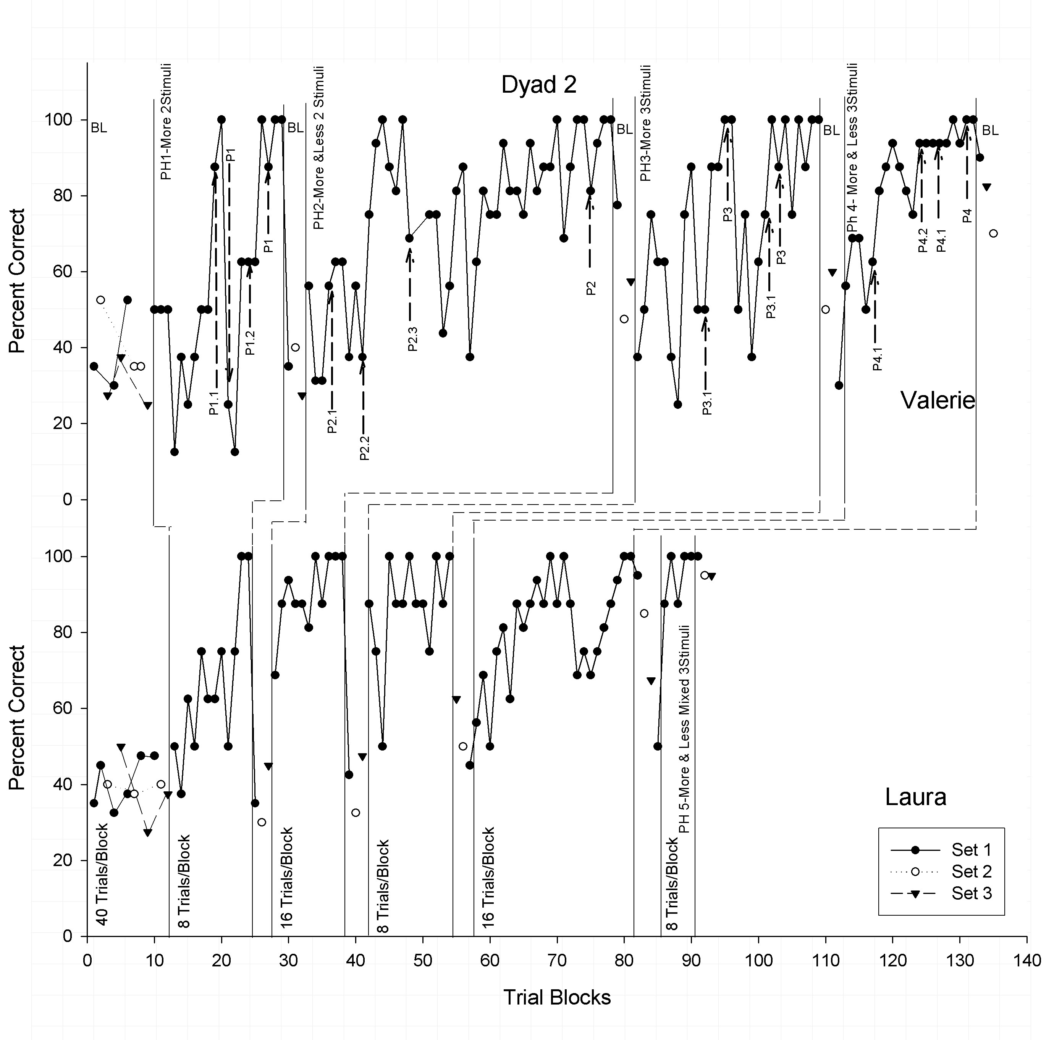
These Could Be Taught
Berens and Hayes, 2007
Teach (with “coins”) “This is more than that. Which would you use to buy candy?”
Steps: A > B; A < B; mixed; A > B > C; A < B < C; mixed; A < B, C > A
Notes:
ALL relations are like this

Slide 27
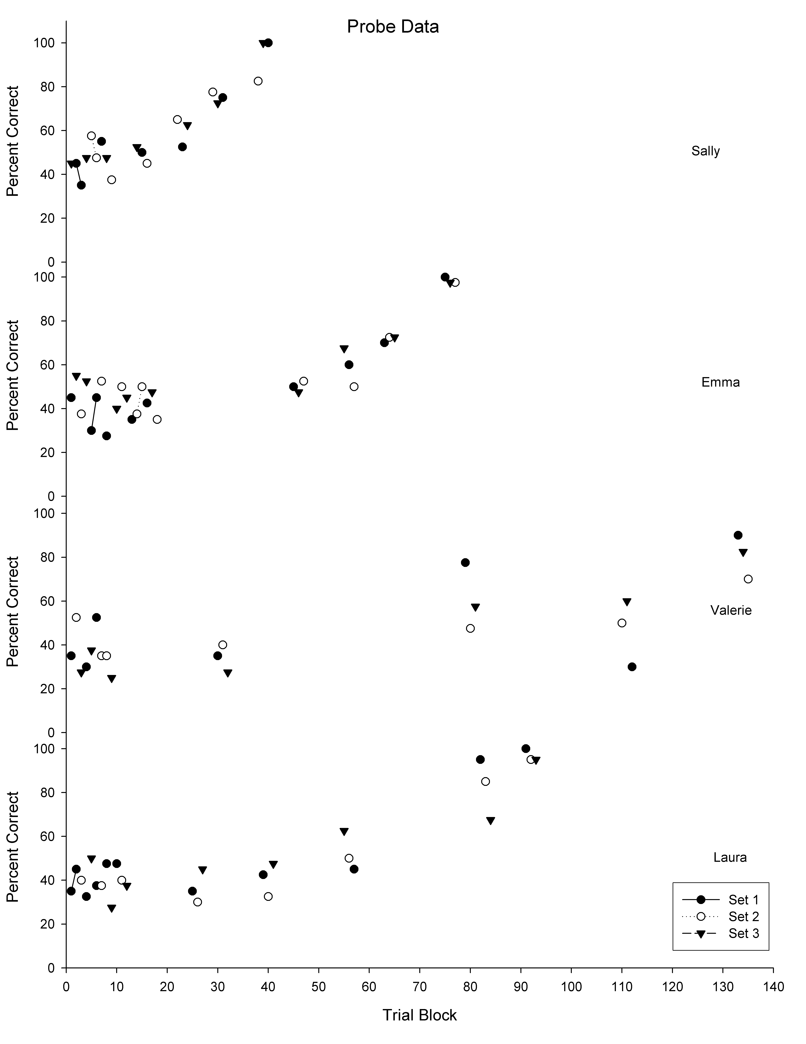
And They Generalized
New
comparative
networks

Slide 28
The Leap in
Relational Frame Theory (RFT)
Symbolic events have their functions because they participate in relational frames
Relational framing is the core skill in language and higher cognition.
Notes:
A leap? Maybe but lets look at what you can do with it

Slide 29
Behavioral Strength
Avoid formalistic errors some of which are in EvoS (e.g., linguistic ability of language trained primates; common sense views of “symbols”; partition into common sense groupings)
Detect interactions of inheritance streams
Fit special processes into general ones where possible, enabling better prediction and influence
Notes:
There was no “black box” and no “tabula rasa”
The analysis of biological systems based on variation and selective retention.
My biases are more (b)VSR than BVSR (and the symbolic stream is a good reason why).

Slide 30
Dealing with Behavioral Weaknesses
But what is truly specific, in determinants
Where is the “verbal community”?
EvoS is corrective
Notes:
There was no “black box” and no “tabula rasa”
The analysis of biological systems based on variation and selective retention.
My biases are more (b)VSR than BVSR (and the symbolic stream is a good reason why).

Slide 31
Examples
Strengths in relational learning
Strengths in joint attention and non-verbal forms of Theory of Mind skills
Alloparenting and eusociality
Cooperation and perspective taking as the key for stimulus equivalence
The accelerator of human culture

